Slide 1


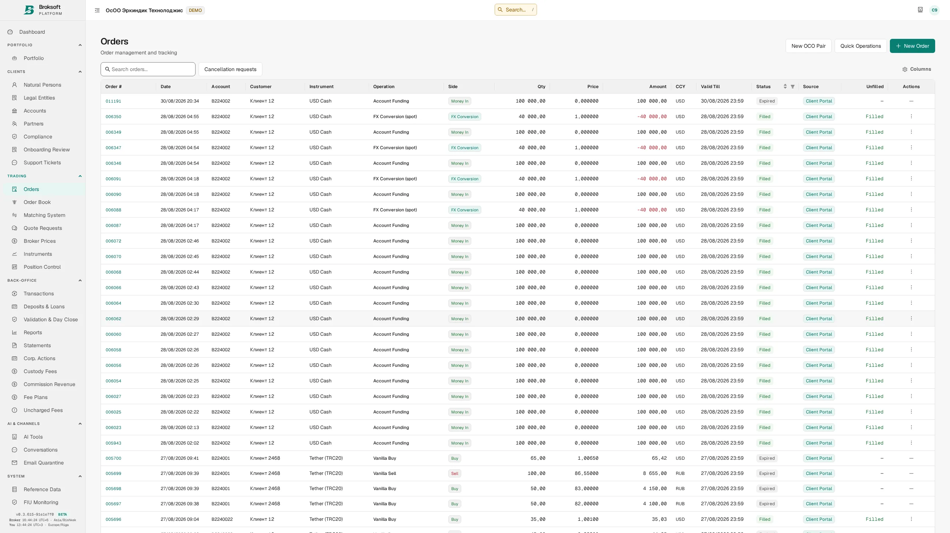
Broksoft
Platform
Brokerage operations and accounting. One platform.
Broksoft connects trading and
settlement operations, the client
portal, accounting, fees and controls.
Built for brokerage firms, custodians,
investment managers and virtual asset
service providers.
Real interface · demonstration data
Explore the documentation
01 / 14
Notes:
Broksoft supports the day-to-day work of a professional financial-services firm, from client instructions through to accounting and reporting. The configuration follows the firm’s activities, asset classes and operating model. In an initial discussion, we identify the workflows that matter most and the teams that will use the platform.

Slide 2







Broksoft
Client journey
From first contact to trading
01
Client
02
Client and firm
03
Client
First contact
Client portal
Forms and documents
Register online or contact the firm.
Set up portal access and the client
profile.
Provide information; review risks
and policies.
04
Compliance
05
Client and firm
06
Client
KYC review
Agreements and access
Trading
Verify information and decide on
onboarding.
Sign agreements; configure the
account.
Place orders in available
instruments and venues.
Configurable journey
Service setup
Stages and documents follow the firm’s procedures.
Account, fee plan and permitted operations.
Explore the documentation
02 / 14
Notes:
The relationship begins when a client contacts the firm or registers online. Online registration includes email verification and access to the client portal. During onboarding, the portal guides the applicant through the required stages.
The firm determines the questionnaire, mandatory documents and review process in line with its procedures. The client provides information and reviews the firm’s risk disclosures, policies and agreements. Staff assess the submitted information and verification results, requesting further information where needed. The sequence is configurable: agreements may be signed before or after the review.
Agreements are signed in the client portal, with the accepted document version recorded. The firm opens and configures the brokerage account, assigns a fee plan and sets permitted instrument types and operations. Available venues depend on the instruments and data sources configured in the platform. Once setup is complete, the client places orders through the same portal.

Slide 3




Broksoft
Operating cycle
From client order to account statement
01
Client
02
Treasury
03
Compliance
Front office · Back office
Client order
Execution
Approval and accounting
Submit an order through the client
portal.
Order book and position control.
Approve transactions and post to
the ledger.
04
Back office
05
Firm
06
Firm and client
Settlement
Day close
Statements and reports
Confirm delivery and payment for
trades.
Check activity; finalise balances
and positions.
Client, regulatory and internal
reporting.
Rules-based automation
Position servicing
Order matching and fee calculation.
Coupons, dividends and redemptions.
Explore the documentation
03 / 14
Notes:
The client submits an order through the portal. Treasury uses Position Control and Market Depth to oversee orders and positions; execution may involve automatic or manual matching of opposing orders. Execution creates transaction records, and the applicable compliance, front-office and back-office checks govern their posting to the ledger. Supported workflows also allow automated validation under the firm’s policy. Fee calculation remains linked to the underlying transaction.
Back office separately confirms actual settlement and monitors delays. Reaching the value date does not, by itself, complete settlement. Day close establishes official balances, positions and P&L; period statements are issued from closed, current accounting records. The same records support management reporting and regulatory data exports. Regulatory reporting scope and formats are agreed during implementation for the relevant jurisdiction.
Corporate actions form a separate position-servicing workflow, covering entitlement calculation, preview and application of payments. Supported events include coupons, cash dividends and redemptions. These are instrument events, not a mandatory stage of every trade.
The firm manages checks and approvals at the supported stages. Posted transactions are corrected through the permitted cancellation or reversal procedures, preserving the accounting history.

Slide 4





Broksoft
Asset classes
Multiple asset classes. A shared accounting system.
Equities
Bonds
Instruments share position accounting,
fee calculation and reporting. Bonds,
derivatives and digital assets have
dedicated parameters and workflows.
Your firm’s activities determine the
module configuration.
Funds
Derivatives
FX
Digital assets
Positions · Fees · Reporting
Explore the documentation
04 / 14
Notes:
Shared accounting mechanisms work alongside asset-specific rules. Bonds have par value, coupons and accrued interest; derivatives have contract lifecycle events; digital assets have networks, addresses and a trading model. The instruments and activities you support determine the modules you need. We use this discussion to understand your current product range and plans for expansion.

Slide 5
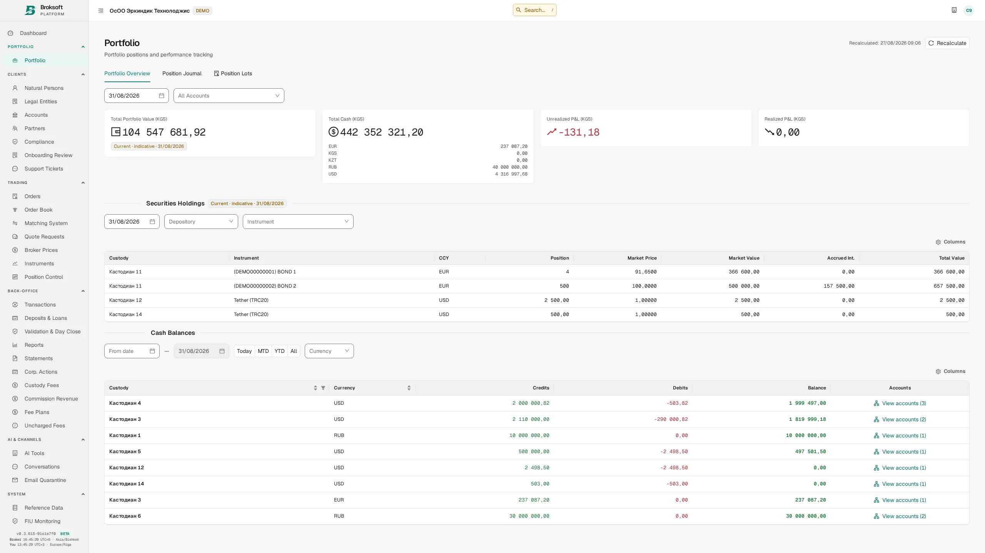
Broksoft
Accounting
Accounting that preserves the transaction history
01
Double-entry accounting and an
immutable general ledger. Permitted
corrections use reversals.
02
Lots, available balances and P&L are
supported by reconciliation and end-of-day
close.
03
Backdated changes flag affected closed
days for recalculation.
Real interface · demonstration data
Explore the documentation
05 / 14
Notes:
The immutable general ledger preserves the accounting history, while permitted corrections are recorded through reversals. Positions are maintained by lot, with average cost or FIFO selected at account level. End-of-day close establishes official valuations and balances. When an operation affects a prior period, the system flags the affected closed days for recalculation. This distinguishes current operational information from the reporting position as at a specific date.

Slide 6
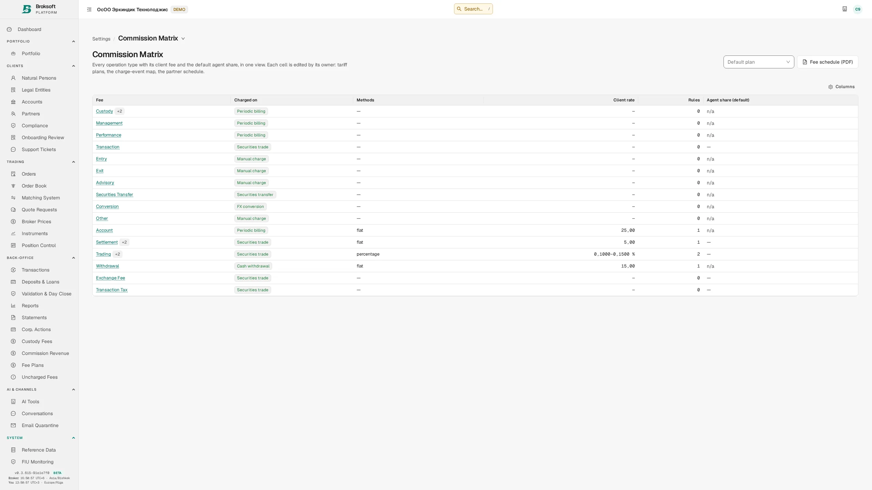
Broksoft
Fees
Fee terms retain their history
01
Fee plans apply to a client or account from
a specified date.
02
A new rate does not rewrite previous
charges.
03
Trading, custody and recurring fees are
supported, with applied rules available for
review.
Real interface · demonstration data
Explore the documentation
06 / 14
Notes:
Fee plans apply to a client or account from an effective date. Changes create a version history, while previous charges retain the rate that applied at the time. Depending on the rule, calculation methods include percentages, fixed amounts, per-unit charges, tiers, minimums and maximums. Custody fees reflect the actual custody location. Which client terms and exceptions are most important in your business?

Slide 7
Broksoft
Controls
Controls are part of the workflow
01
02
03
Client due diligence
Segregation of duties
Decision records
KYC, screening and transaction
monitoring connect to
documents and decision records.
Roles define permissions.
Independent approval follows
configured rules.
The audit trail records who
changed what and when.
Shared client, account and instrument records
Explore the documentation
07 / 14
Notes:
Controls follow the applicable rules and permissions. Independent approval settings take account of transaction type, amount and source. KYC and monitoring produce tasks and supporting material for review, while authorised staff make the decisions. The audit trail links changes to a person and time. Regulatory submission formats and external gateways are agreed for your jurisdiction.

Slide 8
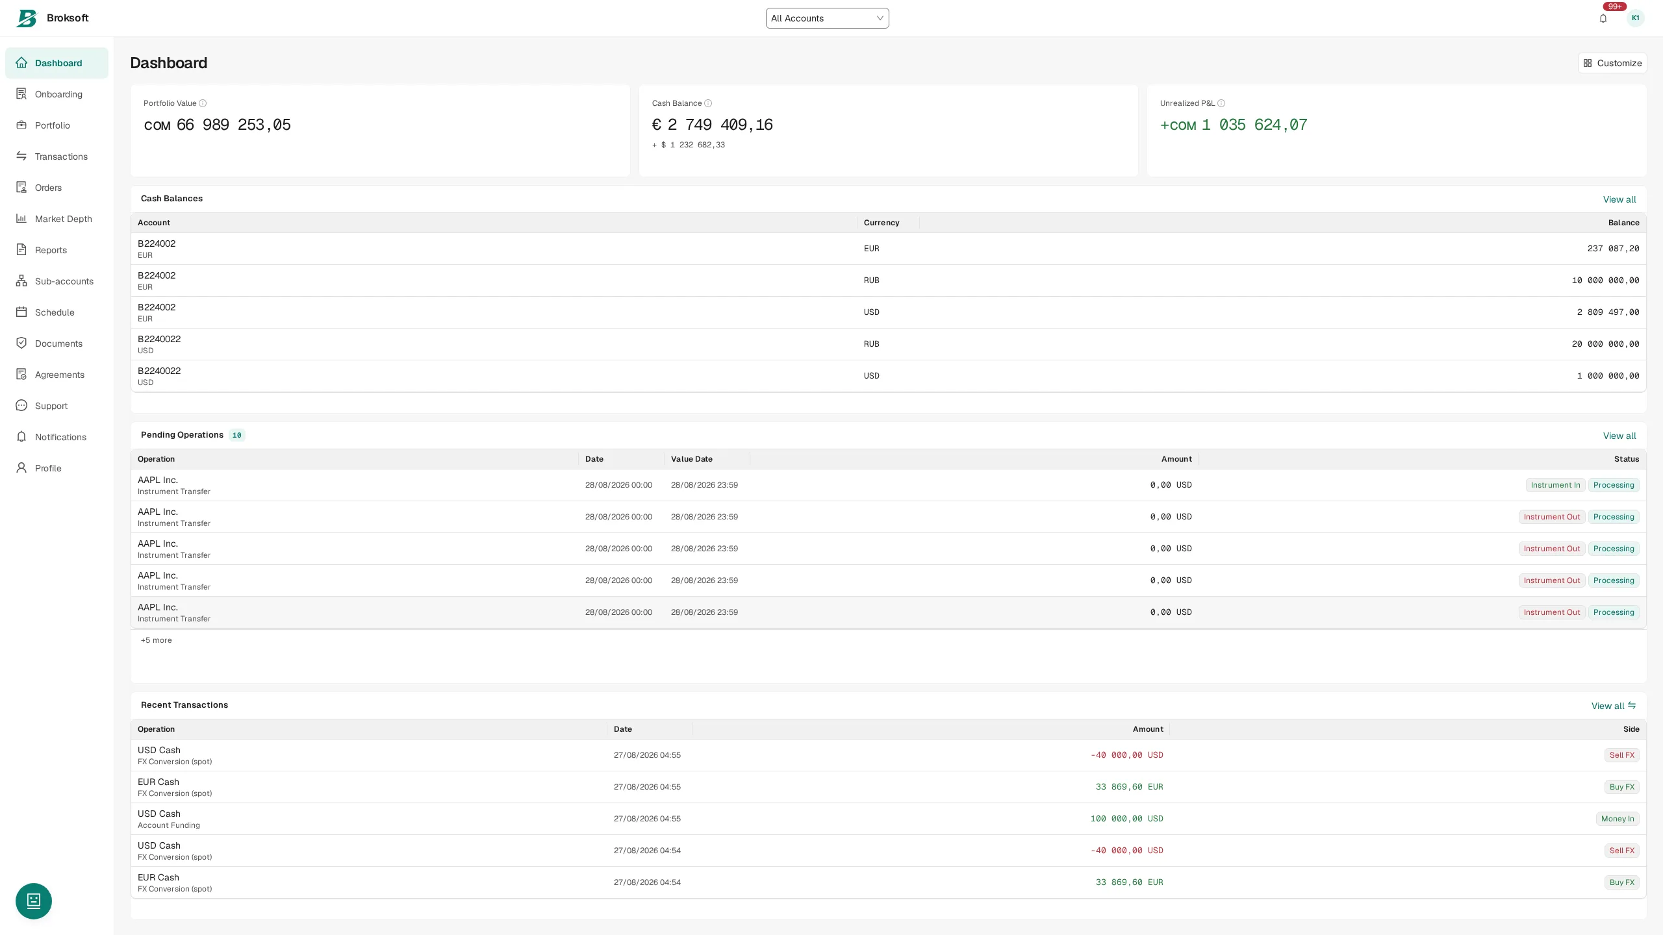
Broksoft
Client experience
A client experience under your brand
01
Portfolios, instructions, statements,
documents and KYC in one portal,
including mobile access.
02
Your logo, domain, client documents and
report branding.
03
The portal uses the same accounting
records as the back office.
Real interface · demonstration data
Explore the documentation
08 / 14
Notes:
The client portal uses the same underlying accounting records as the back office and gives clients access to their own accounts, instructions and documents. It supports mobile browser access. Branding settings cover the logo, domain, colours, client document wording and report headers. Additional client journeys and specific design requirements are discussed as part of implementation.

Slide 9
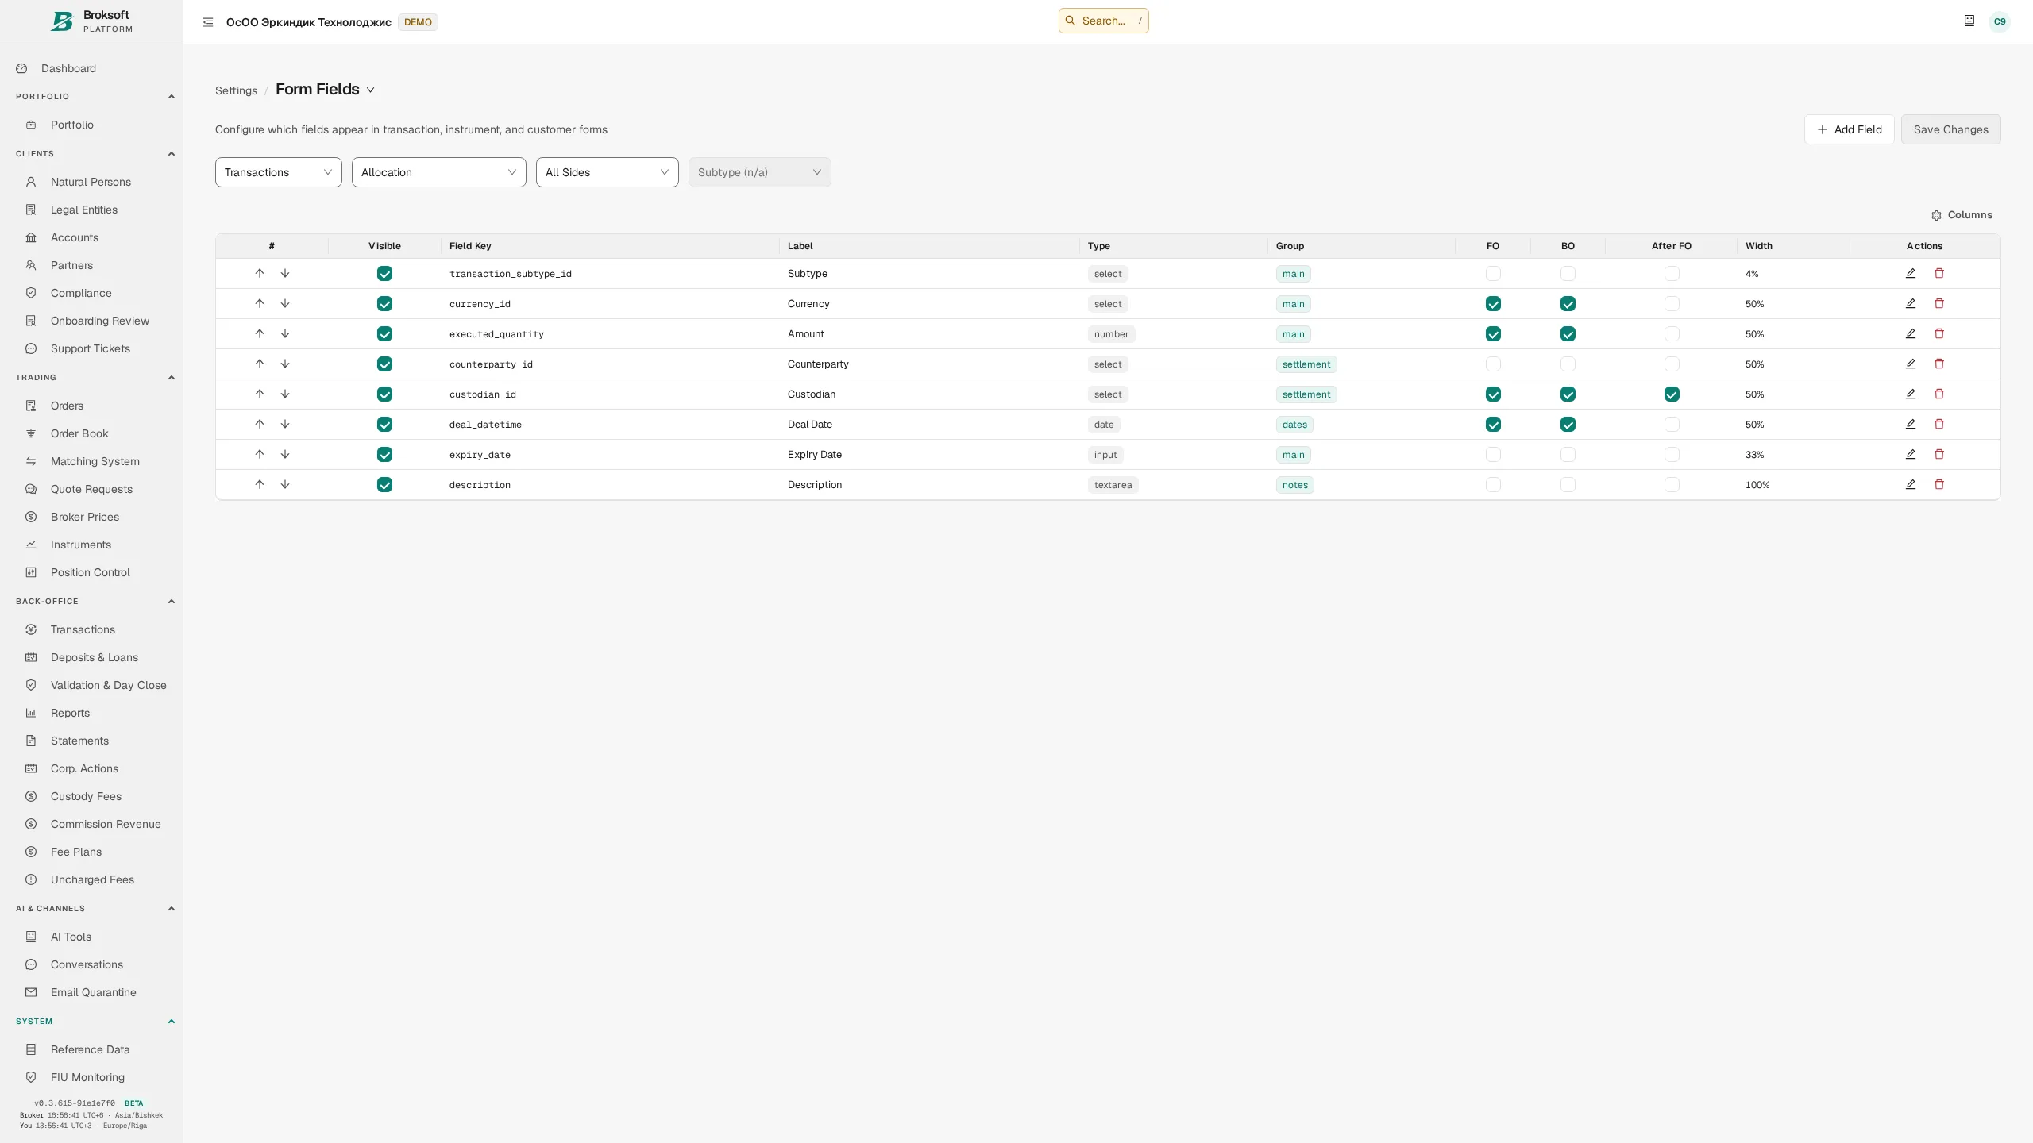
Broksoft
Configuration
Configuration and tools under your control
Supported business logic
Configure fields, fee plans and reference data
within supported business logic.
Staff assistance
AI assists with text, documents and search;
staff review the result.
Financial calculations and transaction
posting remain with the accounting system.
Real interface · demonstration data
Explore the documentation
09 / 14
Notes:
The brokerage team manages fields, fee plans and reference data through the interface, within the platform’s supported business logic. AI assistance can help draft a transaction description, extract information from a document and search uploaded material. Staff review the result; calculations and posting follow the accounting system’s rules. The firm chooses the model and usage limits.

Slide 10
Broksoft
Integration
Connect your systems and data
REST API
REST API with access keys and permissions.
Imports with validation before loading.
Broksoft
Configurable price and exchange-rate
sources with freshness checks.
Imports
Shared accounting
system
External connections and exchange formats
are scoped during implementation.
Market data
Explore the documentation
10 / 14
Notes:
The REST API, file imports and market data sources serve different exchange needs. Before an import, the system previews the proposed records and identifies rows that need correction. Market data includes source and freshness checks. The specific external systems, formats, exchange schedules and required adapters are defined during implementation. Which connections must be available when you go live?

Slide 11


Broksoft
Deployment
Choose your deployment model
01
02
Self-hosted
Managed deployment
Self-hosted: the application and data run
within your infrastructure.
Managed deployment: Broksoft operates
the infrastructure.
Operational and support responsibilities are defined by the chosen model and agreement.
Explore the documentation
11 / 14
Notes:
With self-hosted deployment, the application, database and required components run on your infrastructure. With managed deployment, Broksoft operates the infrastructure on agreed terms. The choice reflects data requirements, internal IT resources and the support model. Each party’s responsibilities and any sharing of technical information for support are agreed separately.

Slide 12
Broksoft
Implementation
A transition grounded in data validation
01
02
03
04
Discovery
Configuration
Migration and
reconciliation
Go-live and
support
Agree the workflows and configuration, then migrate reference data, clients, accounts
and history.
Reconcile cash balances and positions before go-live.
Updates include migration rehearsals on a copy of the data.
Explore the documentation
12 / 14
Notes:
Implementation starts by agreeing workflows, source systems and acceptance criteria. Configuration is followed by migration of reference data, clients, accounts, balances and the agreed transaction history. Cash and securities positions are reconciled before operations begin. Updates include migration rehearsals on a copy of the data. Historical depth, source-data quality and integrations determine the project’s scope and schedule.

Slide 13
Broksoft
Configuration and pricing
A configuration for your business
Choose the modules and deployment model you need.
Self-hosted: a perpetual licence with annual maintenance. Managed deployment: a
subscription.
The website calculator provides an indicative estimate; implementation and additional work are
priced separately.
Estimate your configuration
Explore the documentation
13 / 14
Notes:
The commercial configuration depends on the selected modules and deployment model. Self-hosted deployment uses a perpetual licence with annual maintenance; managed deployment uses a subscription. Current options are available in the website calculator. The final proposal considers client volumes, the selected configuration, implementation and additional work. We can review the configuration together with your team.

Slide 14


Broksoft
Next step
Let’s discuss your operating model
Tell us about your business, markets, clients
and existing infrastructure.
We will demonstrate the relevant Broksoft
workflows and define the implementation
scope. Explore the documentation for a detailed
view of the platform.
Documentation
broksoft.com/docs/en/
Capabilities · Workflows · Implementation
info@broksoft.com
Explore the documentation
14 / 14
Notes:
The next step is a focused discussion and a demonstration of the workflows relevant to your firm. Useful inputs include your activities, jurisdiction, asset classes, client volumes, existing systems and required connections. From these, we can identify a suitable configuration and an initial implementation scope. The documentation is available for your operations and technology teams to explore the product in detail.

